Slide 1

EasyWay
Sprint 5
Subject: CS692
Computer Science Project 2
Designed By:
Vidisha Vijay Sawant

Slide 2

Agenda

Slide 3
Agenda
Team members roles and responsibilities
Improvements made from professor feedback
Project description
Team working agreement
Personas
MVP
Technologies
Algorithm
Diagrams
Sprint 4 Recap
Product Backlog
Sprint 5 Backlog
Metrics
Retrospective
Sprint 6
Project Demo
Github link
Live application Demo

Slide 4

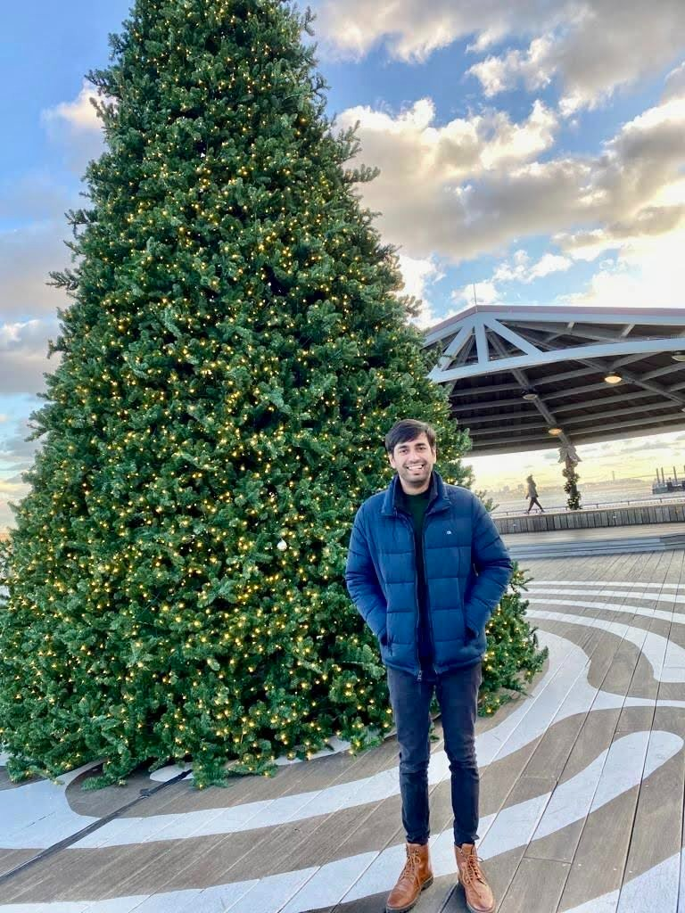
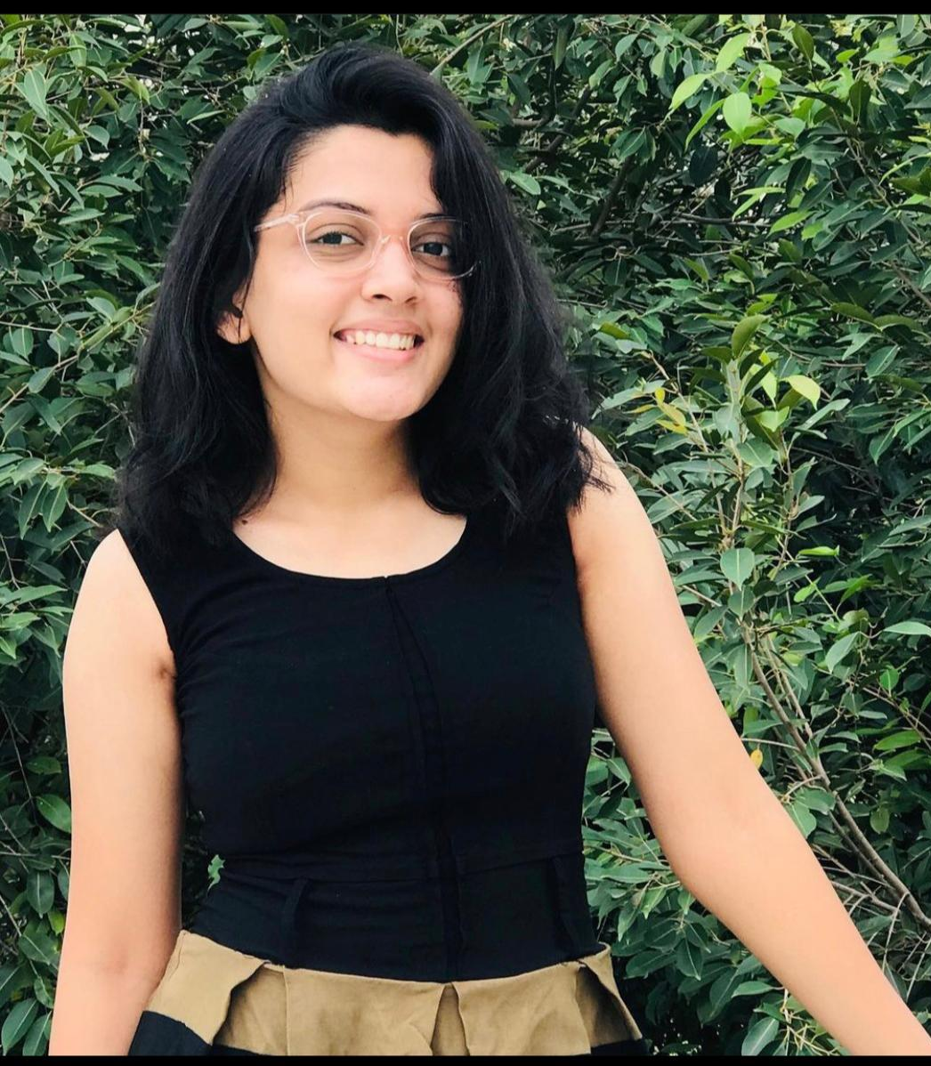
Team Member Roles
Vidisha Vijay Sawant
Developer
Kshitij Sharma
Developer
Femina Baldha
Developer

Slide 5

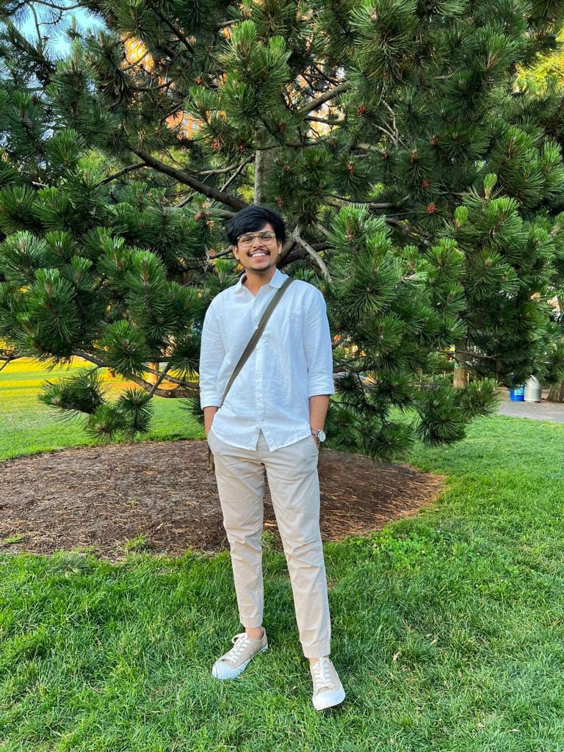

Team Member Roles
Aditya Kadarla
Project Manager
Quality Analyst & Tester
Shubham Sawant
Business Analyst & Developer
Ravi Kumar Dabbada
Database Administrator

Slide 6




Improvements made from Professor Feedback
No Feedback

Slide 7
Project Description
Project Description
Project Name: | EasyWay
Team Name: | D-Coders
Project Description: | Get instant access to reliable, certified, and affordable on-demand home services. For customers who want to book on-demand home services, the EasyWay is a web app that provides a hassle-less booking of a home service, unlike the traditional way where we had to call or text and ask for any professional's availability our solution provides the availability of any professional online with booking service.
Benefit Outcomes: | Users can book services according to their preferred date and time. Users can see the services categories and can click on them to see the booking screen.
GitHub Wiki: | https://github.com/ksharma67/EasyWay/wiki

Slide 8
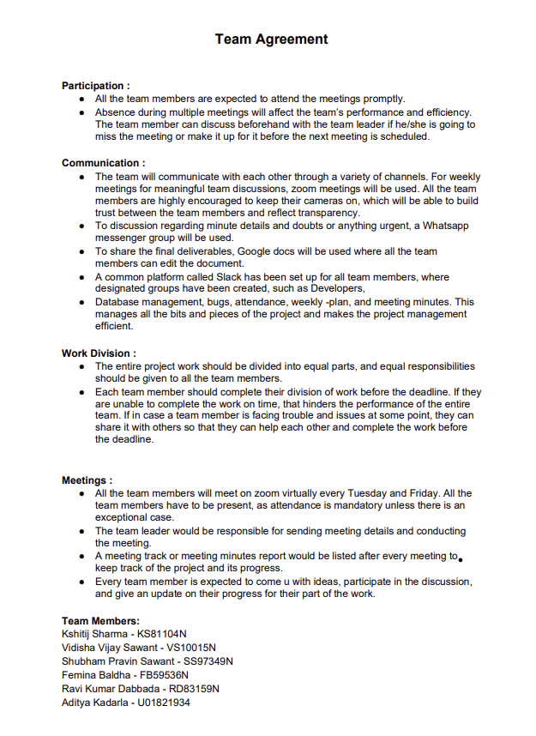
Team Working Agreement

Slide 9

Personas

Slide 10
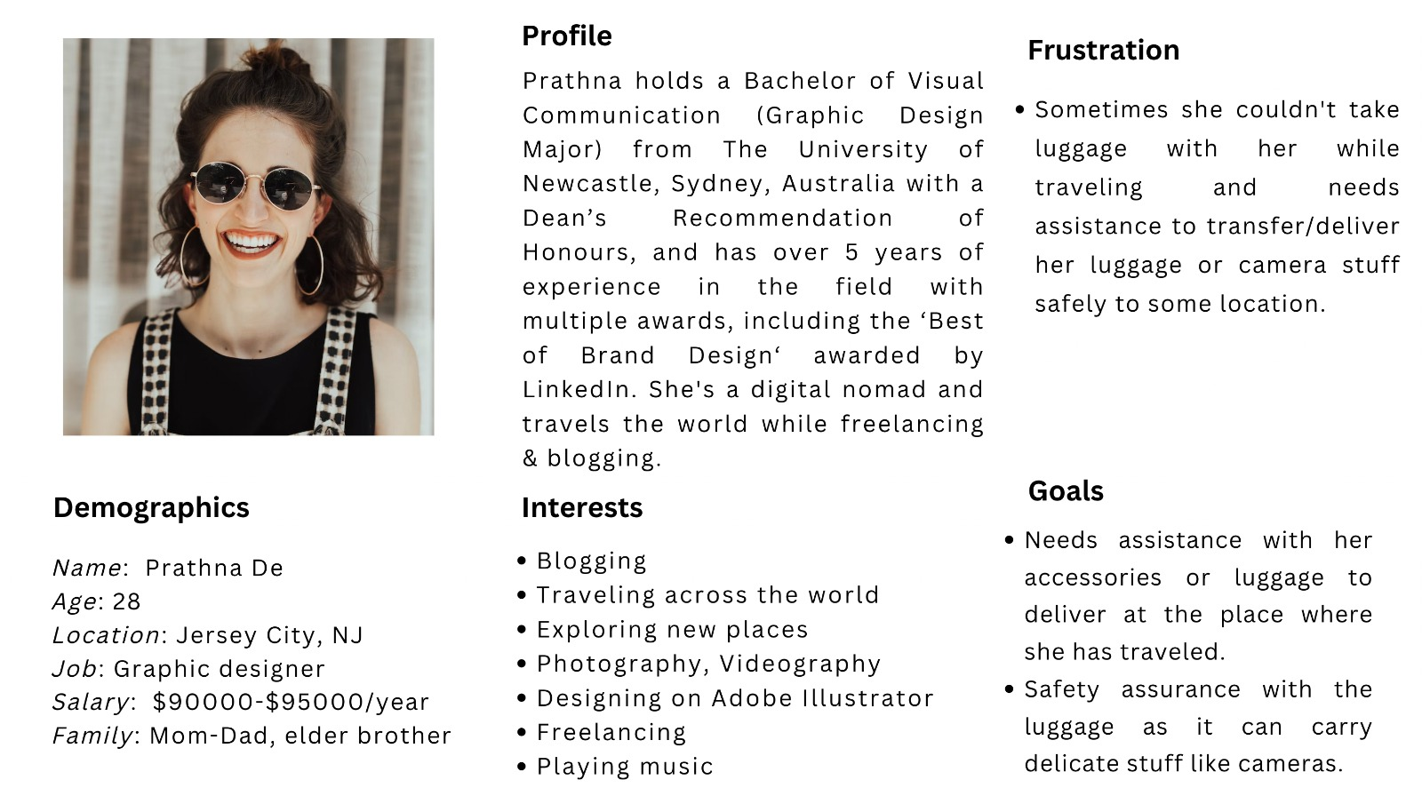
Persona 1

Slide 11
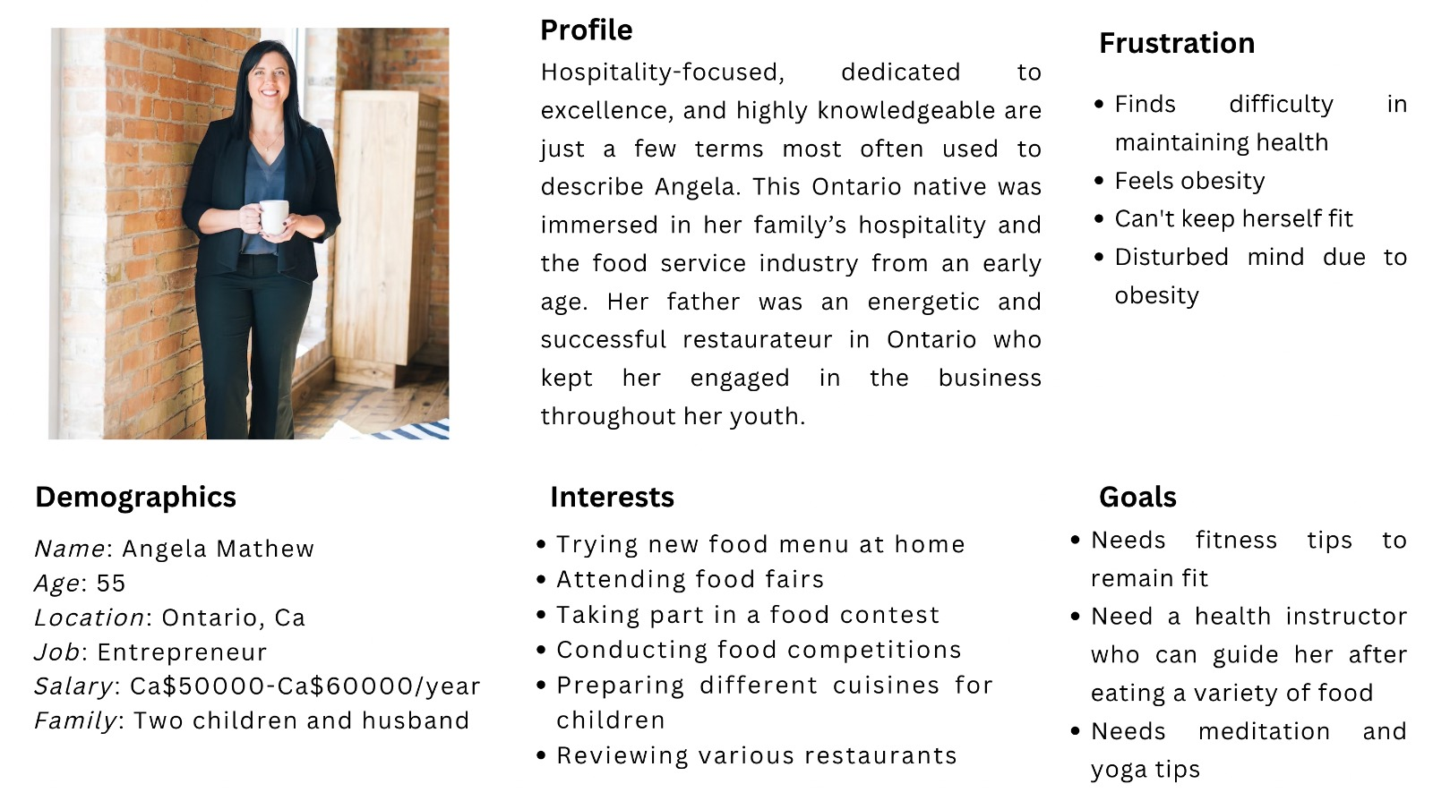
Persona 2

Slide 12
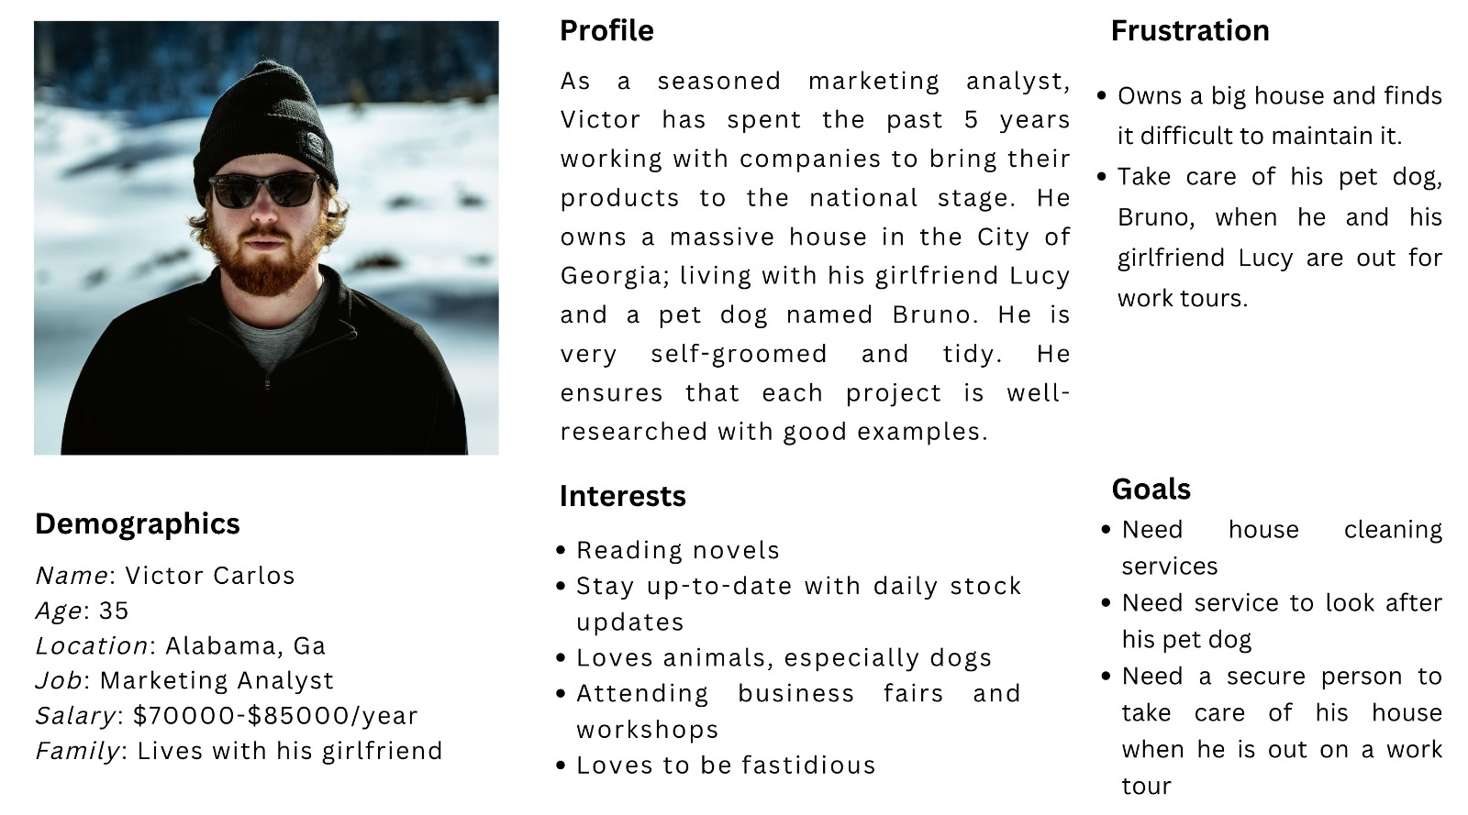
Persona 3

Slide 13

Minimal Viable Product (MVP)
Homepage
Service Catalog
Cancel Booking
Registration – Customer and Professional
Login – Customer and Professional
Book – Calendar and Time
Booking Confirmation via email or in-app

Slide 14
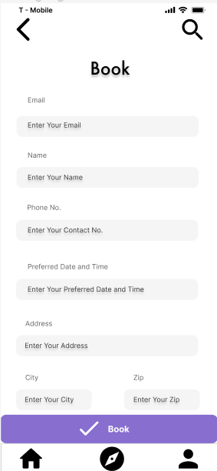
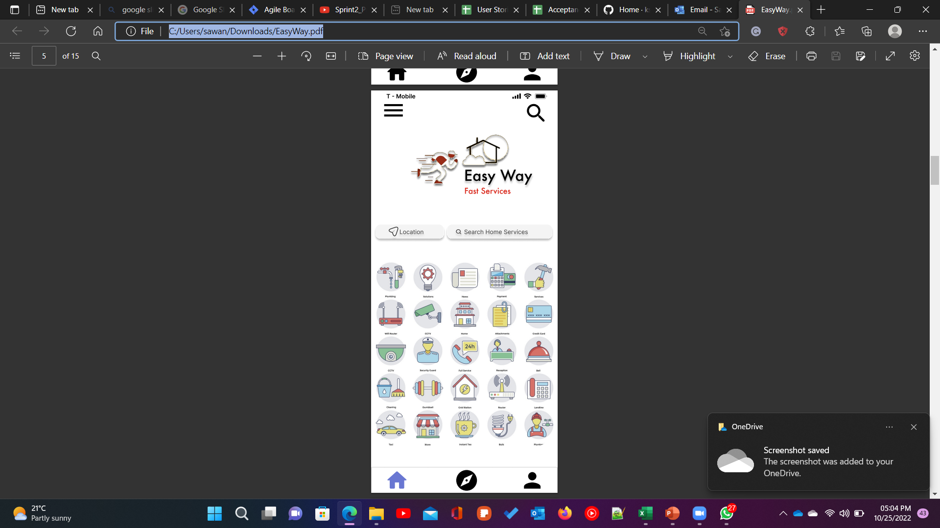
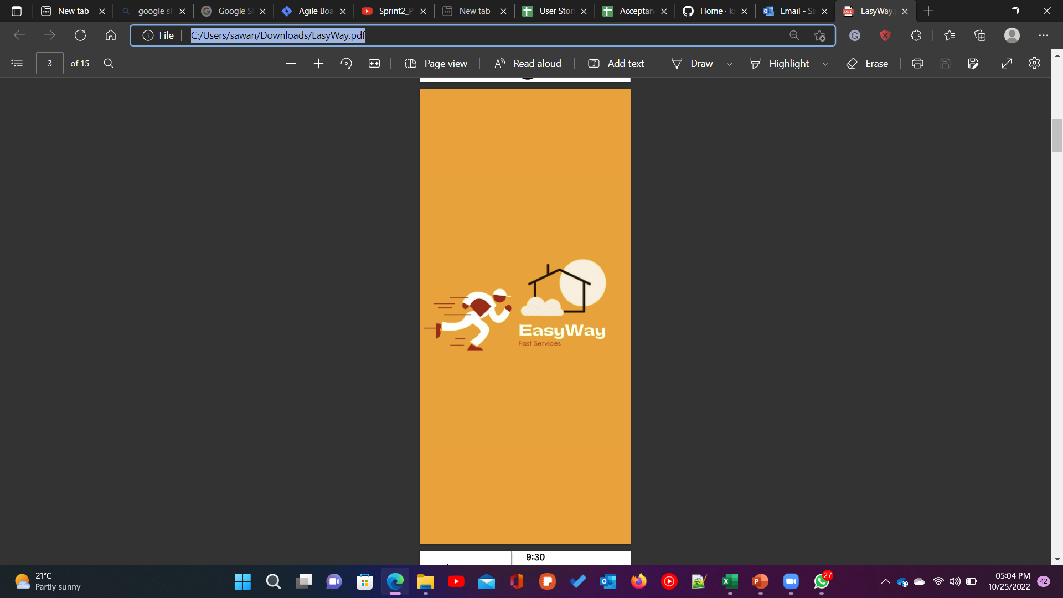
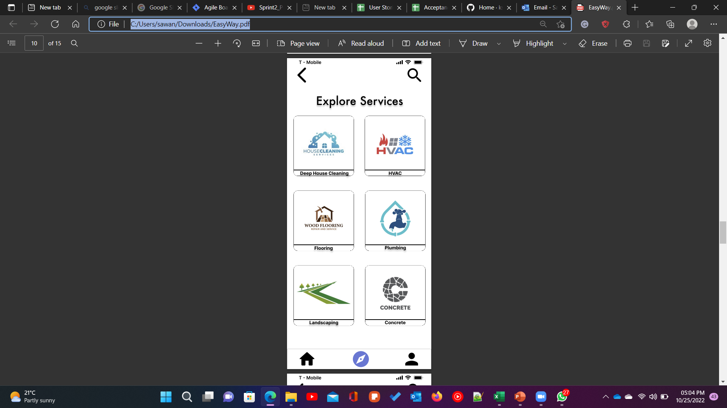
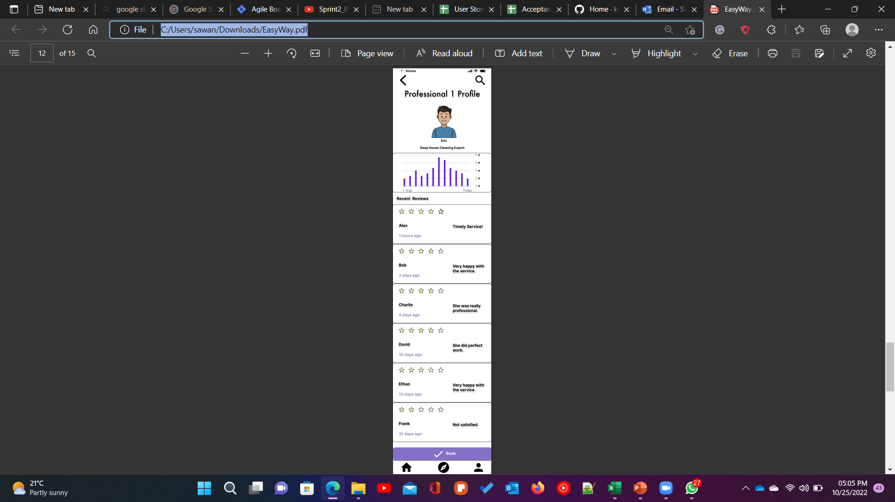
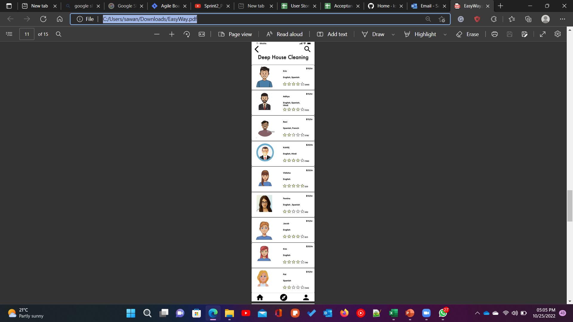
Minimal Viable Product (MVP)

Slide 15
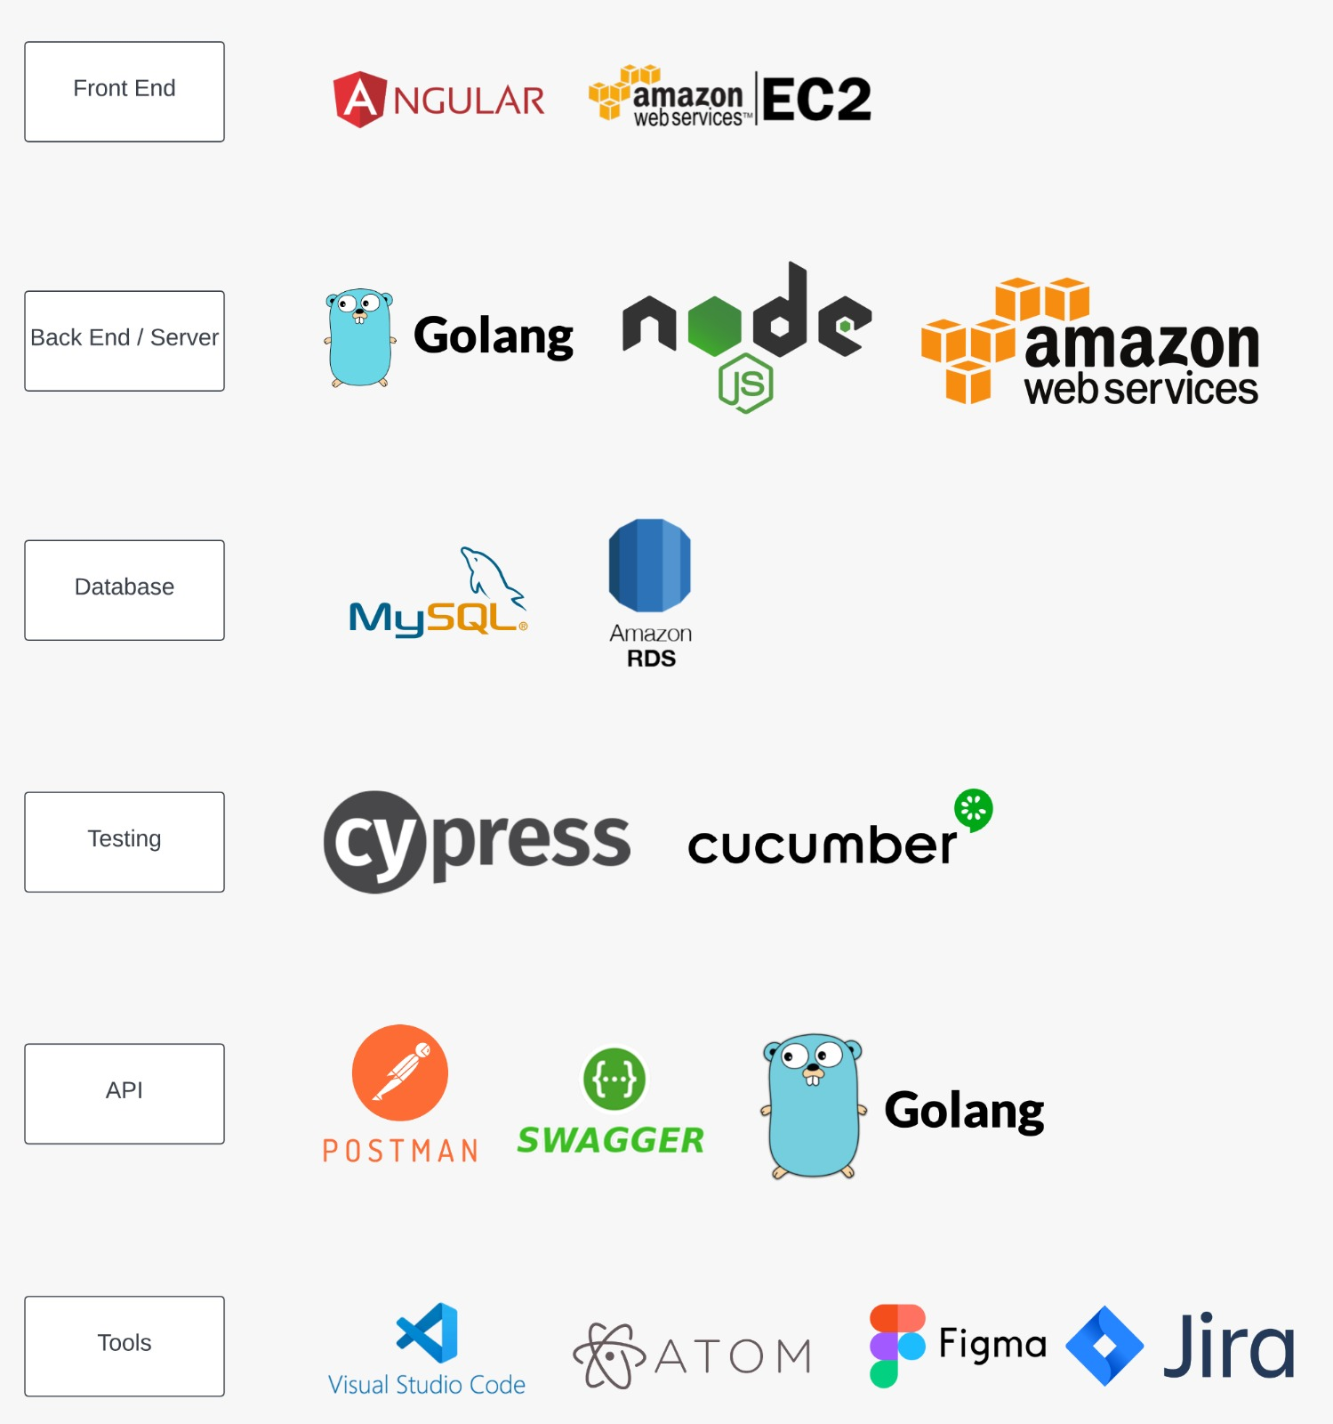
Technologies

Slide 16
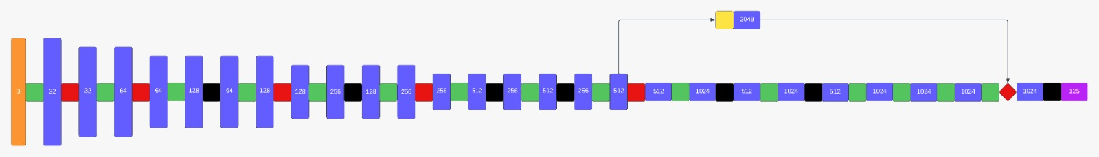
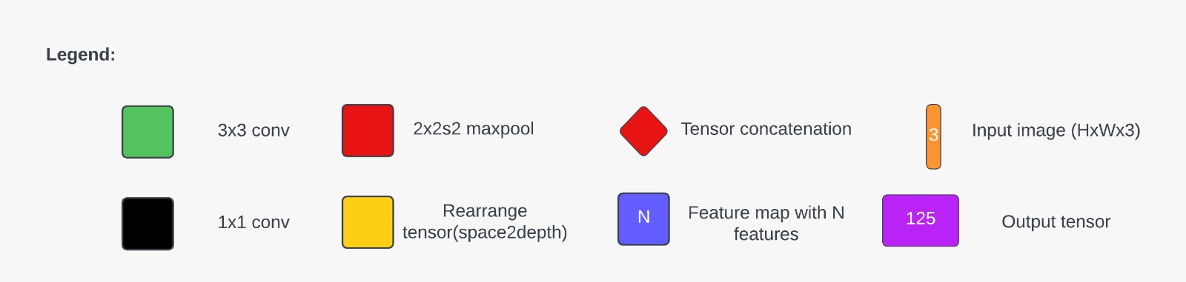
Algorithms

Slide 17

Diagrams

Slide 18
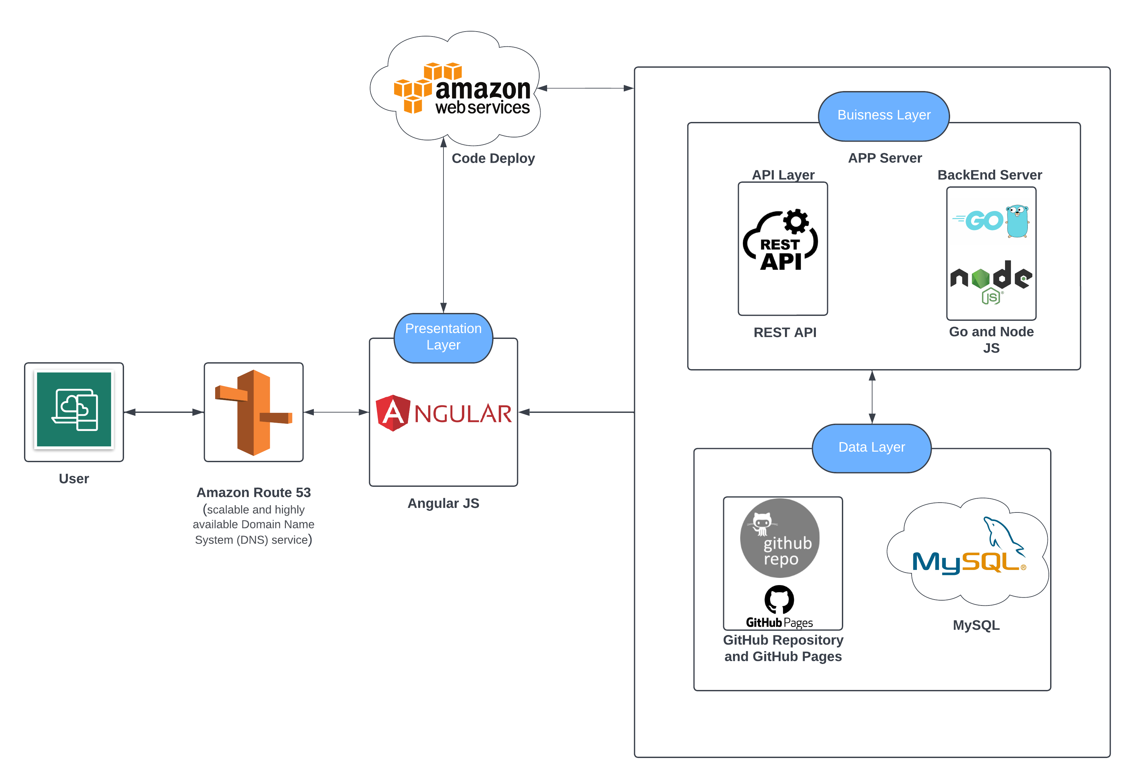
Conceptual Architecture Diagram

Slide 19
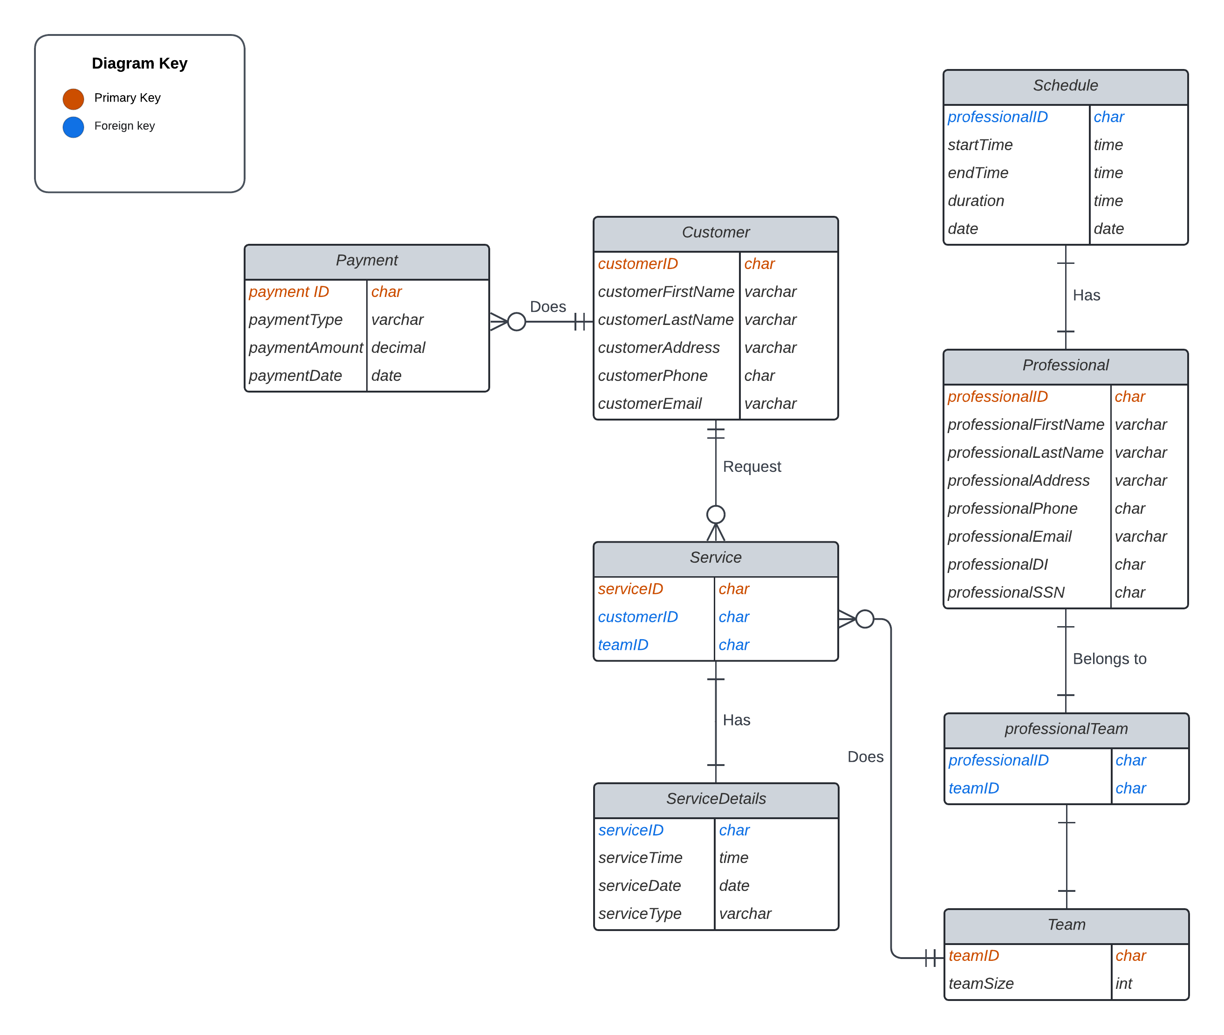
ERD Diagram

Slide 20
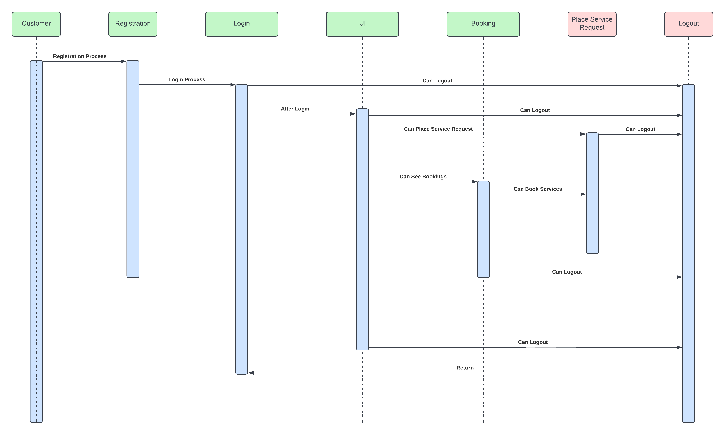
User Sequence Diagram

Slide 21
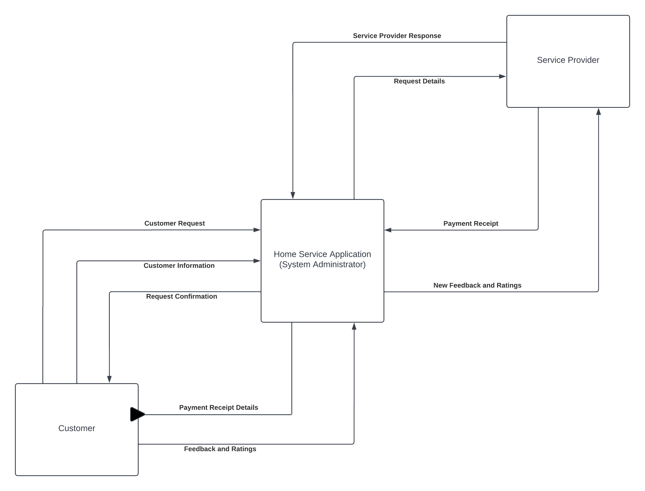
Data Flow Diagram Level 0

Slide 22
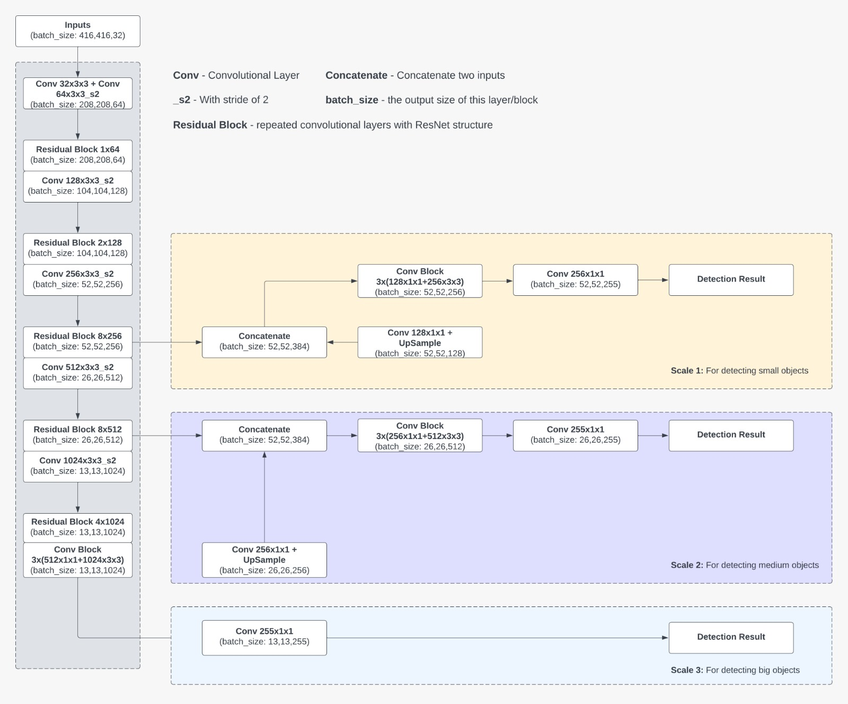
Algorithm Network Architecture

Slide 23

Sprint 4 Recap

Slide 24
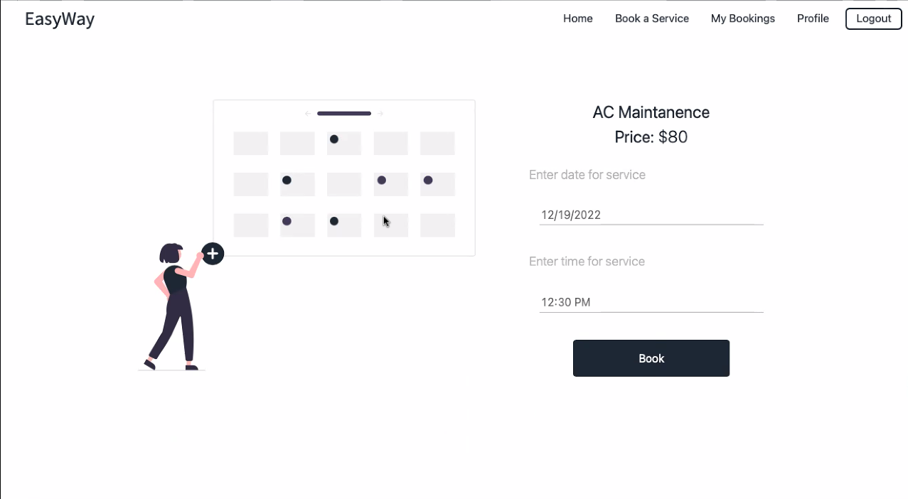
Booking Page

Slide 25
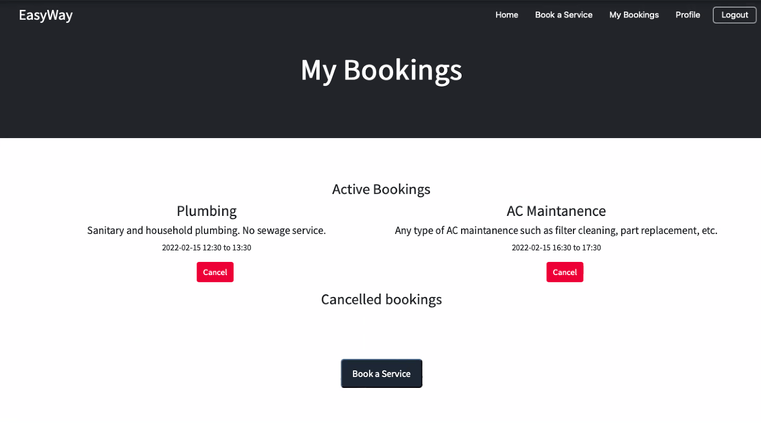
My Booking Page

Slide 26
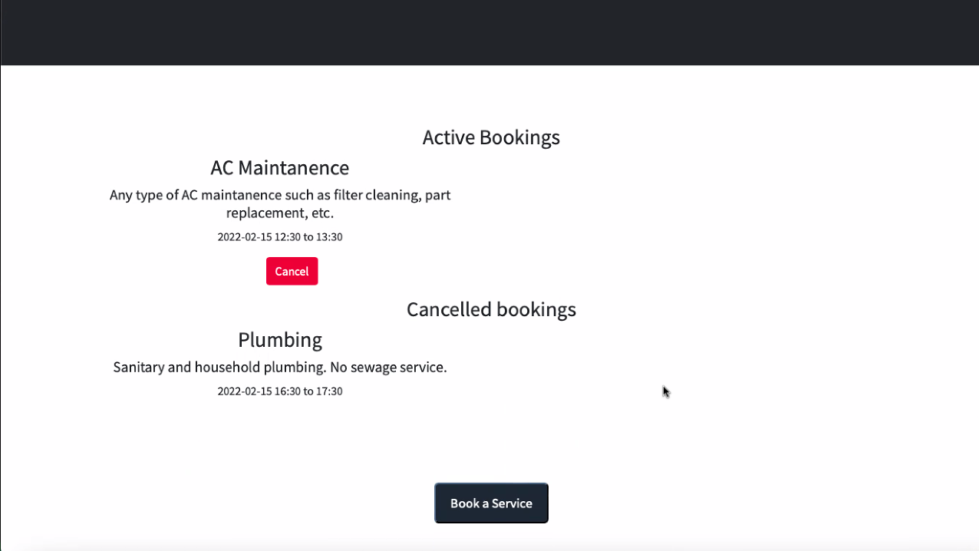
Cancel Booking

Slide 27
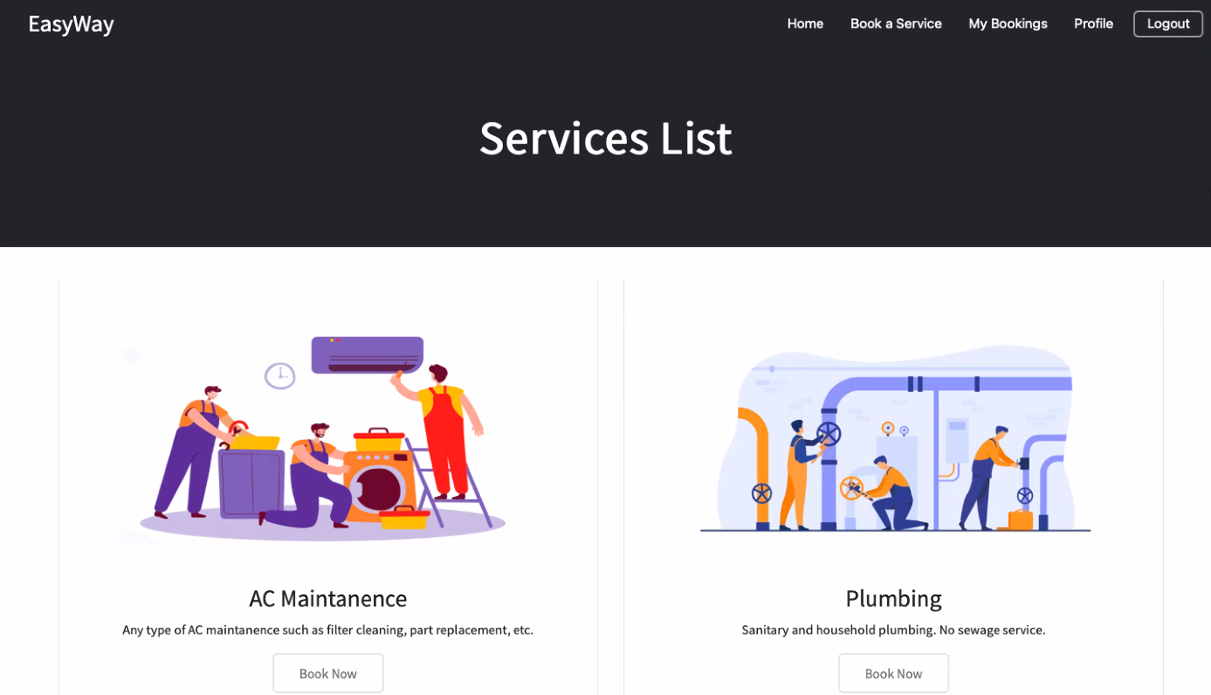
Navigation Bar

Slide 28
Sprint 4 Vs Sprint 5
Booking Page
Cancel Booking
Navigation Bar
Initial implementation of the object detection algorithm
New Backend Libraries

Slide 29
Product Backlog
Issue Type | Key | Name
Task | DCS-65 | Improving Object Detection Model Accuracy
Story | DCS-64 | As a customer, I want to able to search on the webpage, So that I can find necessary information
Story | DCS-63 | As a customer I want to be able to recover my account customer ID/Name So that I will be able to access my account in case i forgot the account.
Story | DCS-62 | As a customer I want to able to recover the passwords to my account So that I will be able to access my account in case i forgot password.
Story | DCS-61 | As a customer, I want to email customer service So that I can get my issue resolved
Story | DCS-45 | As a customer I want to browse all the professional home services provided. So that I have a list to select the service I want.
Story | DCS-41 | As a customer I want to able to submit feedback So that the website owners can consider my opinion or concern during future website updates
Story | DCS-40 | As a customer, I want to be able to access quick services near me So that I will be able to book an urgent situation at my house.
Story | DCS-39 | As a customer I want to be access the services according to categories such as water, furniture, beauty, etc So that I will be able to access the see the services available and who the professionals are
Story | DCS-38 | As a customer I want to be directly able to contact the technician via call/text So that I will be able to have a better service

Slide 30
Product Backlog
Issue Type | Key | Name
Story | DCS-37 | As a customer, I want to be able to prepone or postpone my booked service So that I can expect the professional on some other date or time.
Story | DCS-35 | As a customer, I want to be able to add multiple address So that I can use them to schedule a service for my office.
Story | DCS-33 | As a customer, I want to browse the service list So that I can get some information what does this particular service do.
Story | DCS-32 | As a signed-in customer I want to able to comment on a blog post So that I can get feedback on issues

Slide 31
Sprint 5 Backlog
Issue Type | Key | Name | Story Points Estimate
Task | DCS-57 | Research on image classification ML algorithms | 8
Task | DCS-46 | Designing an Object Detection Working Architecture Diagram | 3
Task | DCS-44 | Developing an initial Object Detection Algorithm. | 3
Task | DCS-43 | Installing Python v3, Numpy, cv2, matplotlib, torch, subprocess, os, time, argparse, time, and Tensorflow libraries in Backend. | 5
Task | DCS-42 | Designing an Object Detection Network Architecture Diagram | 5

Slide 32
Stories and Acceptance criteria
User Stories And Acceptance Criteria
User Story ID | Summary | Status
DCS-24 | As a customer, I want to be able to cancel my booked service So that I can not expect the professional to reach my home. | Done
 | Scenario: customer want to cancel a booking “Given I’m in a role of logged-in customer When I open the Booking History page Then the system shows me the confirmation tab for cancelling And when I click on Yes it should cancel my booked service.
DCS-50 | As a customer, I want to see the services booked by me So that I can track it. | Done
 | Scenario: Customer wants to track the appointment "Given I'm a logged-in customer When already scheduled an appointment Then I would be able to track the appointment date and time of the booking along with details of the technician.
DCS-52 | As a customer, I want a navigation bar to go between pages, login and out, and search for specific events So that I may use the app more efficiently | Done
 | Scenario: Customer wants to navigate between pages “Given I’m in the role of a guest customer When I click on any tab on the header of the Landing Page Then the system should redirect me toward the clicked tab And the redirect page should be loaded.
DCS-23 | As a customer, I want to choose the date and time of the service So that it is available at my convenience | Done
 | Scenario: Customer wants to see the available date and time “Given I’m in the role of guest customer When I open the services catalog page Then I click on one of the services it redirects me to the booking page And I should be able to see the available dates and times to book.

Slide 33
Test Cases
User Story ID | Unit to test | Assumptions | Test data | Steps to be executed | Expected Results
DCS - 12 | Login | Login should be successful | Email - test@easyway.com, Password - test123 | Homepage -> Login | Check results on entering valid User Id & Password
DCS - 12 | Login | It should show an error as "Invalid Username or Password" | Email - test@easyway.com, Password - test | Homepage -> Login | Check results on entering Invalid User ID & Password
DCS - 12 | Login | It should show an error as "Invalid Username or Password" | Email - easy@easyway.com, Password - test | Homepage -> Login | Check response when a User ID is Empty & Login Button is pressed
DCS - 13 | Sign Up | Sign Up should be successful | Email - any, Password - anything in between 8 to 16 char | Homepage -> Sign Up | Check results on entering valid User Id & Password
DCS - 13 | Sign Up | It should show an error as "Username already in use" | Email - test@easyway.com, Password - test123 | Homepage -> Sign Up | Check results on entering Already in Used User ID
DCS - 13 | Sign Up | It should show an error as "Enter the Password with given parameters" | Email - test@easyway.com, Password - test | Homepage -> Sign Up | Check response when a Password is containing all the given parameters
DCS - 49 | Profile | Profile creation should be successful | Email - test@easyway.com, Password - test | Homepage-> Login-> Profile | Check all the details filled with valid zip codes and phone numbers.
DCS - 49 | Profile | Show an error with missing fields | Email - , Password - test | Homepage-> Login-> Profile | Check to missing/mandatory fields*
DCS - 18 | Homepage | Services should be categorize and listed | localhost:4000/services | Homepage | Check if the categories are correct
DCS - 48 | Services | Display service catalog | db.getCollection("catalog").find({}); | MongoDB -> use Easyway
DCS - 51 | Professionals | Display list of professional | db.getCollection("professional").find({}); | MongoDB -> use Easyway
DCS - 49 | Customer | Insert a customer | db.customer.insert({name:"customerName",customerEmail:customer@test.com, customerPassword:12345678, customerPassword2:12345678}) | MongoDB -> use Easyway | Create a new user in customer database
DCS - 49 | Customer | Display all the customers | db.getCollection("customers").find({}); | MongoDB -> use Easyway
DCS - 18 | Homepage | Customers should be able to access the homepage | localhost:8080 | Homepage | Once directed with url, you will be first redirected to homepage.
DCS - 0 | Dummy Data | Display all collections | show collections | MongoDB -> use Easyway | All tables should be listed
DCS - 43 | Forgot password | Should direct to the email to reset the password |  | Homepage-> Login -> Forgot Password | Password Reset and directed to login page again
DCS - 24 | Homepage | Customer should be able to search the desired services on search box |  | Homepage-> Search box | Homepage must provide the search box for user to search for desired services.
DCS | Chatbot | Customer can interact and receive a response. |  | Homepage-> Login-> Book an Appointment-> Chat | One the chat started both customers and professional can chat in it.
DCS | Chatbot | Customer should be able to book appointment just by interaction and chatting with the chatbot |  | Homepage-> Chatbot | Homepage must provide the chatbot to clear all queries
DCS | Homepage | History displayed in search field should be relevant to logged in user only |  | Homepage-> Search box | Search box on Homepage must display relevant information previously searched by the user.
DCS | Service Page | Services should have filter option based on reviews and time arrive |  | Homepage ->Services -> Filter | Check if the results after correctly filtered

Slide 34
Stories \ Task Completed and Not Completed
Issue Type | Key | Name | Status
Task | DCS-57 | Research on image classification ML algorithms | Done
Task | DCS-46 | Designing an Object Detection Working Architecture Diagram | Done
Task | DCS-44 | Developing an initial Object Detection Algorithm. | Done
Task | DCS-43 | Installing Python v3, Numpy, cv2, matplotlib, torch, subprocess, os, time, argparse, time, and Tensorflow libraries in Backend. | Done
Task | DCS-42 | Designing an Object Detection Network Architecture Diagram | Done

Slide 35

Metrics

Slide 36
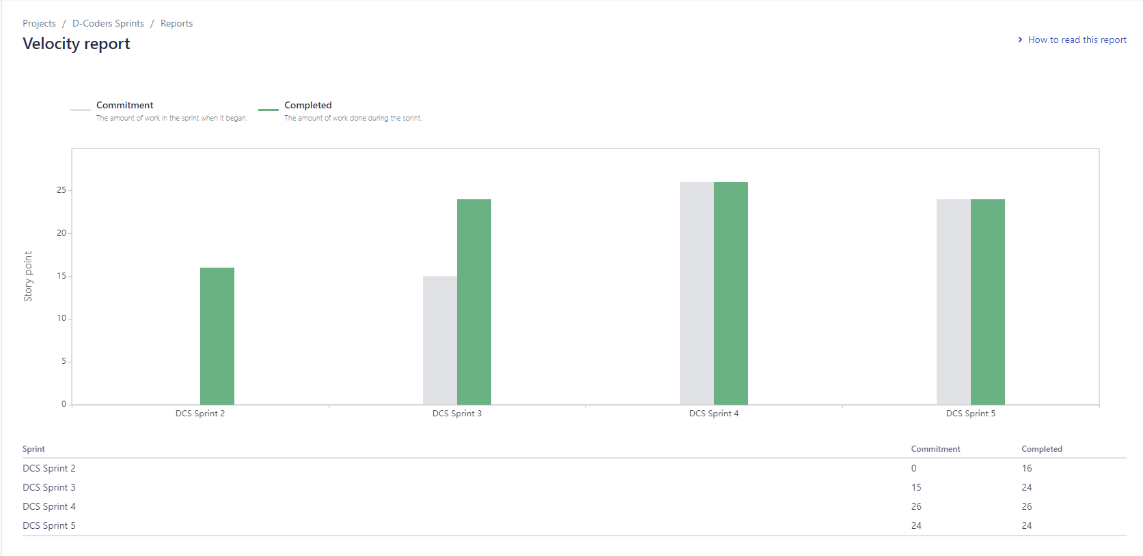
Team Velocity Chart

Slide 37
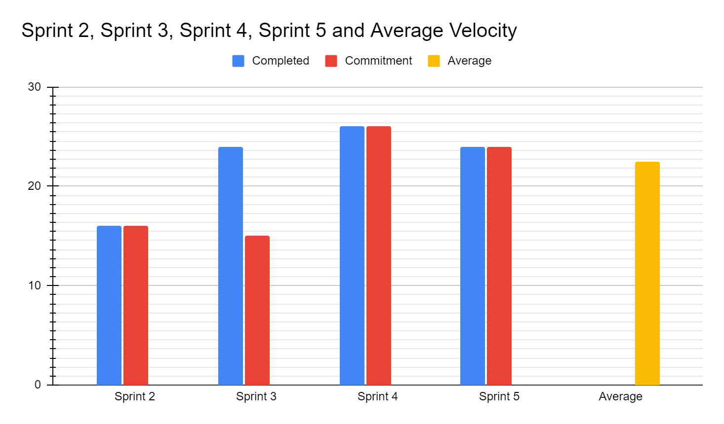
Team Historical Velocity (Average)

Slide 38
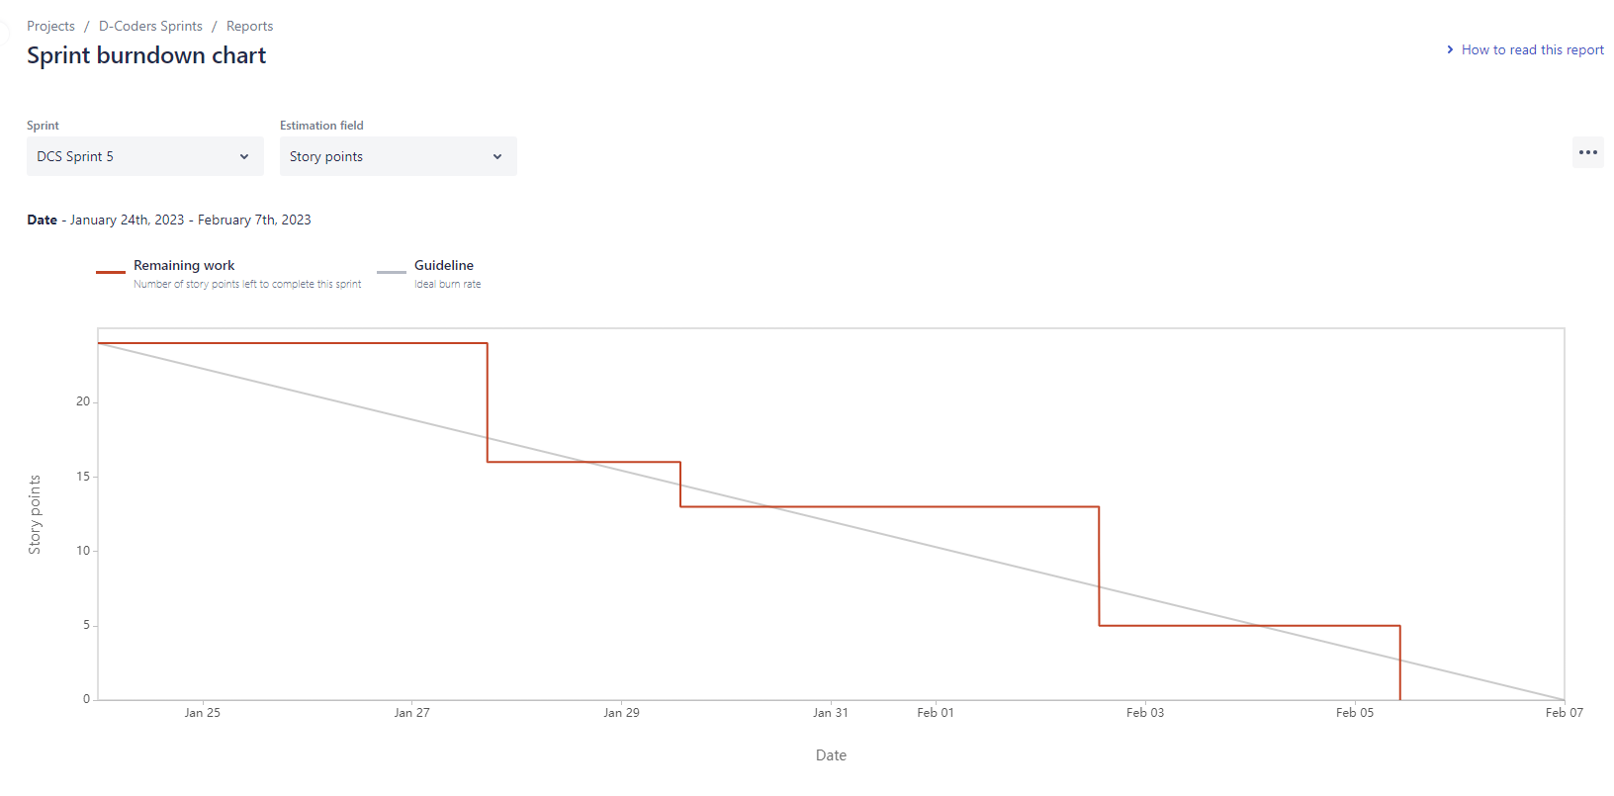
Burndown Charts

Slide 39
Completed / Committed Ratio

Slide 40

Retrospective

Slide 41
What Went Well
Team meetings helped one another out with tasks.
Tasks were clearly defined and assigned on the first day of starting the sprints
We found best fitting libraries to work on for object detection
We finished the presentation on time.

Slide 42
What Needs Improvement
Due to the difference in time zone, we were lacking communication often. Most of our tasks got delayed because of it.
A deadline on when things need to be completed and getting updates on it in every meeting was not met.
Not staying on schedule. Some of the members of the team are still procrastinating.

Slide 43
Next Steps
Team members need to take more self-initiative.
We should split the deadlines into 2 different dates for drafts and final drafts.
Have everyone bring up at least one idea/item issue in weekly planned meetings.

Slide 44

Sprint 6

Slide 45
Stories planned and committed for Sprint 6
Issue Type | Key | Name | Status | Story Point Estimate
Task | DCS-65 | Improving Object Detection Model Accuracy | To Do | 8
Story | DCS-64 | As a customer, I want to able to search on the webpage, So that I can find necessary information | To Do | 5
Story | DCS-63 | As a customer I want to be able to recover my account customer ID/Name So that I will be able to access my account in case i forgot the account. | To Do | 5
Story | DCS-62 | As a customer I want to able to recover the passwords to my account So that I will be able to access my account in case i forgot password. | To Do | 3
Story | DCS-61 | As a customer, I want to email customer service So that I can get my issue resolved | To Do | 3

Slide 46

Project Demo

Slide 47
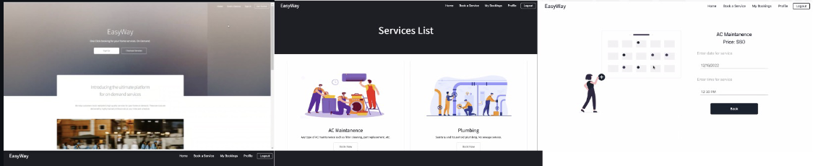
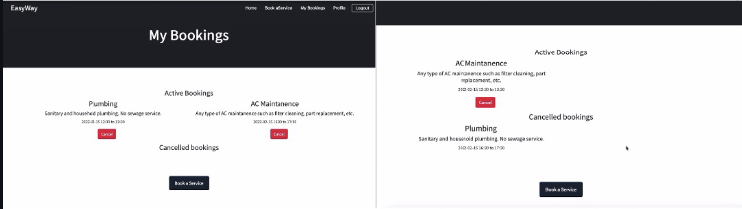
Slides App Screenshot

Slide 48

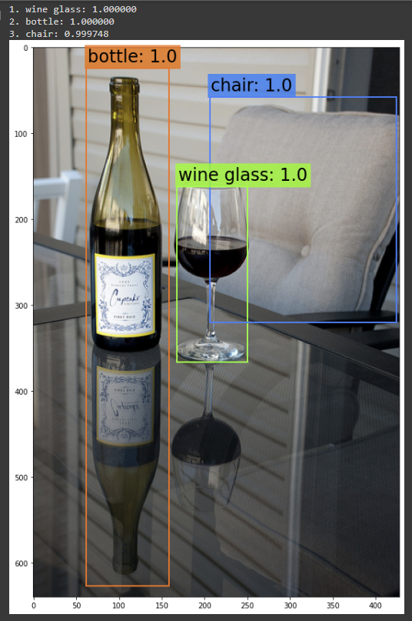
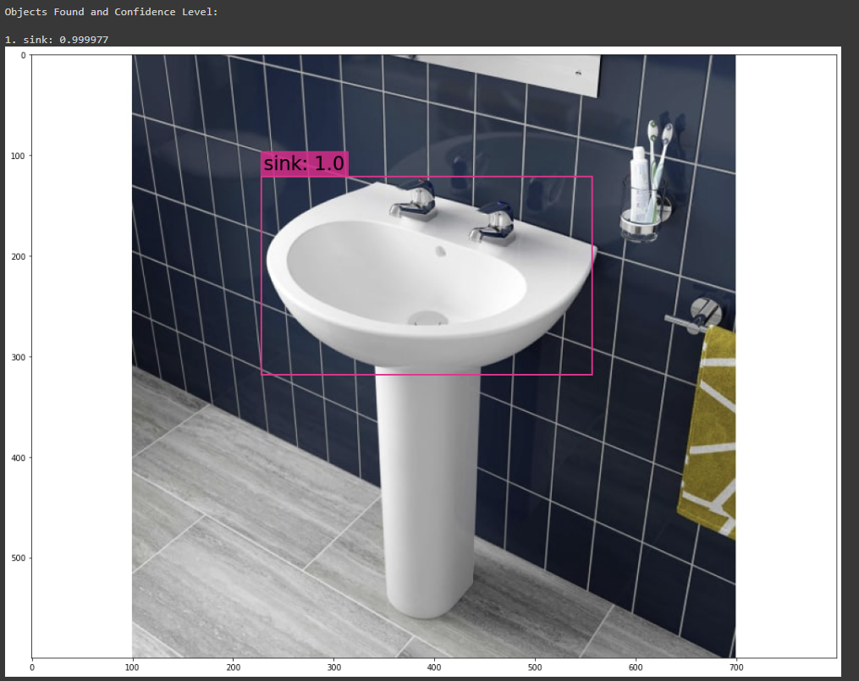
Slides App Screenshot

Slide 49
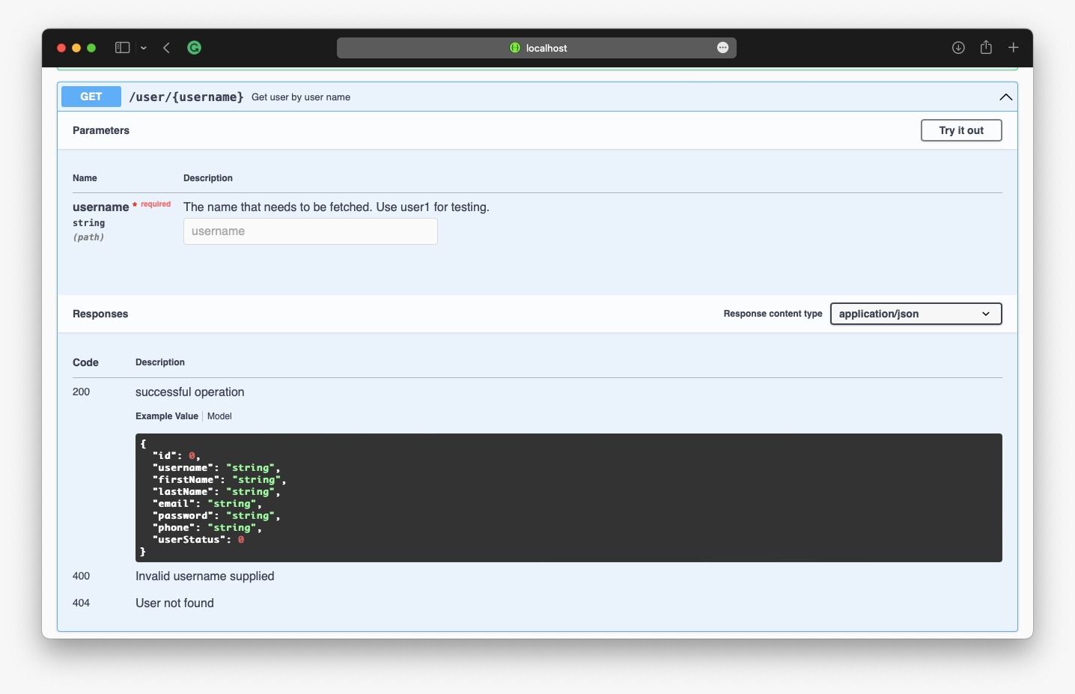
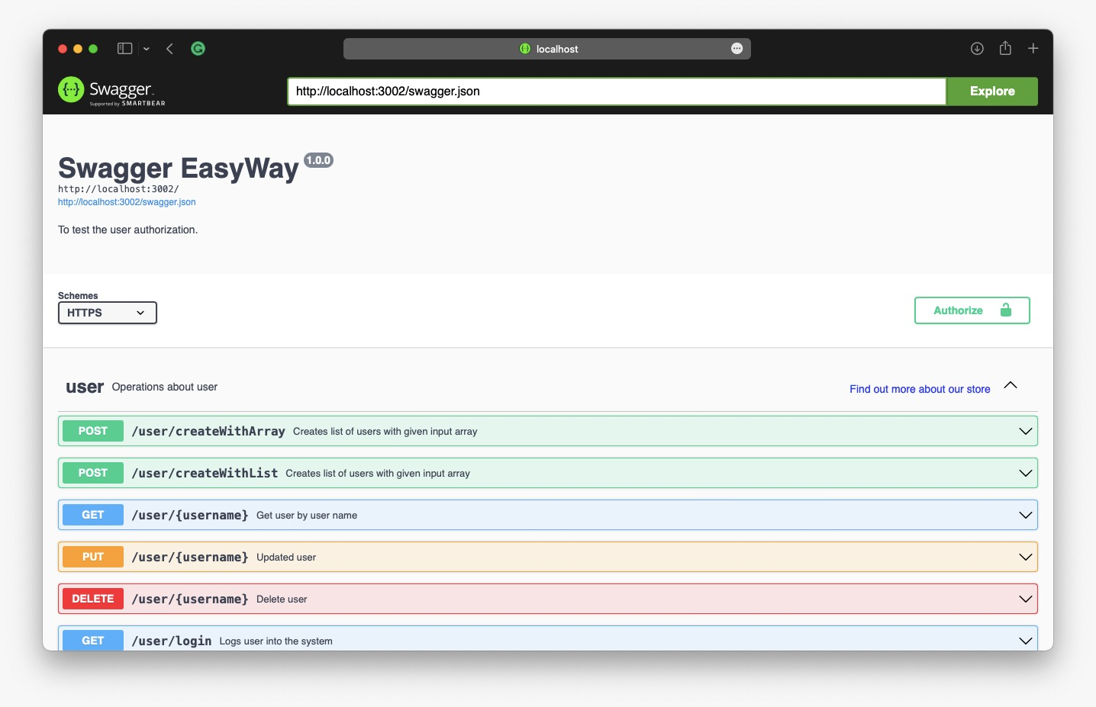
Slides for API

Slide 50
GitHub Link
Home · ksharma67/EasyWay Wiki (github.com)
Technical Paper Link
EASYWAY TECHNICAL PAPER (GITHUB.COM)
Installation Manual Link
EasyWay/Installation Manual.pdf at main · ksharma67/EasyWay (github.com)
API Documentation
EasyWay/API Documentation.pdf at main · ksharma67/EasyWay (github.com)

Slide 51
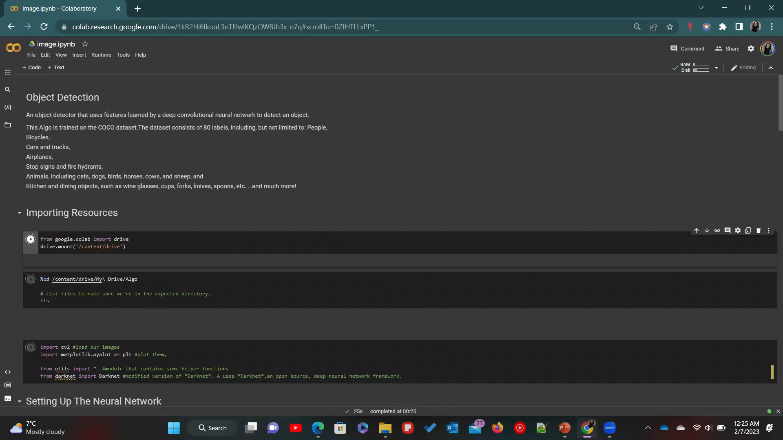
Live Application Demo

Slide 52

Thank You From D-Coders

